Slide 1

Community Health Partnership Flexible Veteran Housing Fund 2024
Training and Overview
Notes:
Welcome to the Community Health Partnership Flexible Housing Fund training presentation.

Slide 2
Our Beliefs
Systems are fundamentally flawed, which prevents people from thriving.
A different type of leadership is needed to create transformative change.
Change is possible and non-negotiable.
Our Mission
To transform the way people work together to solve complex community health issues.
Our Vision
Collaboration, connectedness, and equity form the foundations of thriving communities, where everyone has what they need to flourish.
How we Work
Listen + Learn – Our work starts by paying attention and absorbing information, no matter who we engage.
Convene + Engage: We create space for diverse voices and meet people where they are.
Innovate + Rebuild: We collaboratively re-engineer flawed systems.
Notes:
PLEASE READ: CHP is a 501(C)3 organization formed in 1992 by local health leaders to foster a collaborative approach to improving the health of the region. Our vision is to pioneer a process of collaborative leadership that results in measurable improvements in community health. We use collective impact as our primary collaboration framework and we currently serve as a backbone organization and support four complex local initiatives that work to prevent and end homelessness, suicide, and substance use disorders in our community, and increase access to competent healthcare for LGBTQIA2+ individuals.

Slide 3
Brief Overview: What is the Veteran Flex Fund?
The Community Health Partnership (CHP) Flexible Veteran Housing Fund has set aside funding to remain flexible and accessible to highly vulnerable veteran households experiencing or at risk of experiencing homelessness, or who are experiencing a housing crisis in El Paso County, Colorado. The goal of the Veteran Flex Fund is to help households resolve their housing crisis through diversion efforts and move them towards permanent housing solutions.
Notes:
The CHP FF has set aside funding to remain flexible and accessible to highly vulnerable households experiencing or at risk of experiencing homelessness. The goal of the fund is to help HH resolve their housing crisis through diversion efforts to move them towards permanent housing solutions.

Slide 4
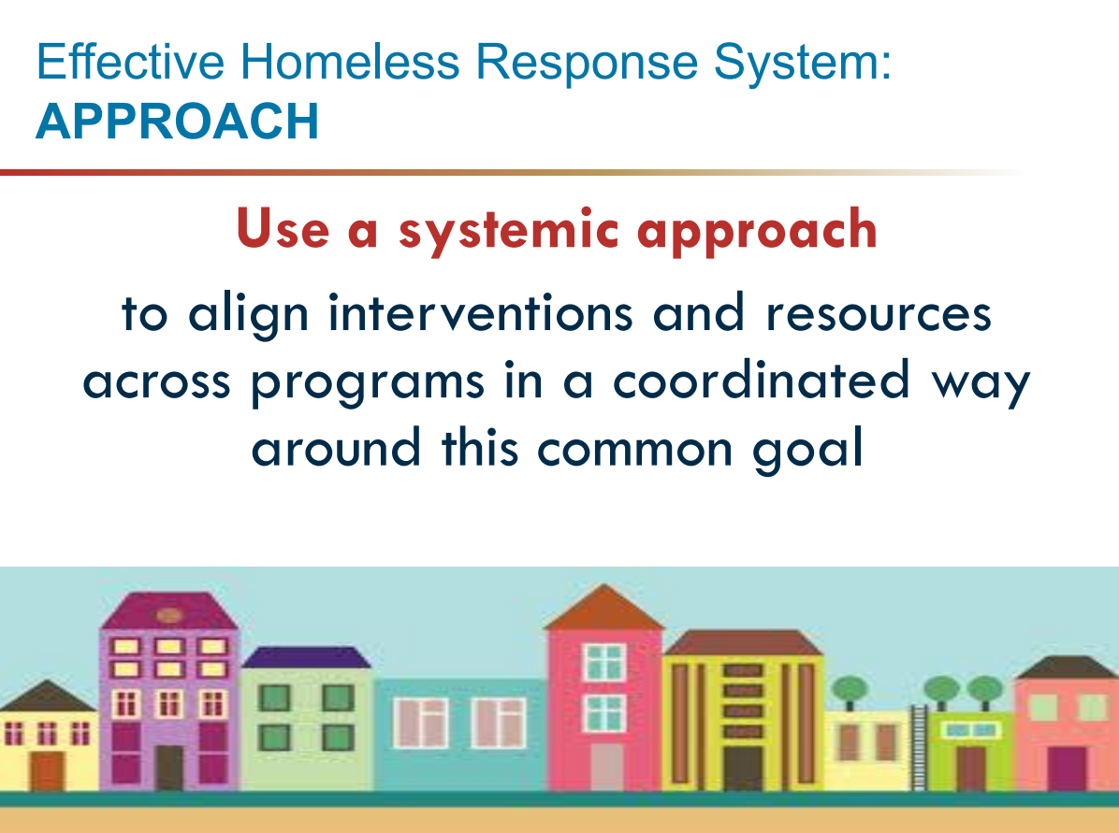
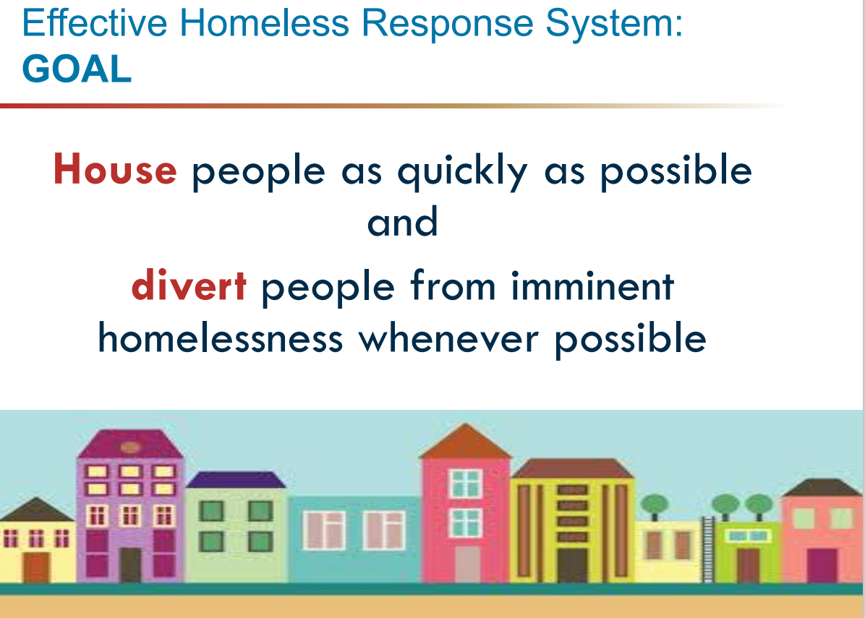
Using Veteran Flex Funds to Support Diversion Efforts
What is Diversion?
  Diversion assists people who have just lost their housing and are seeking emergency shelter or facing homelessness.
Action Steps to Problem-Solve:
  Understand
  Explore
  Pursue
How to Support Households:
  Connect or reconnect with friends and family
  Resolve Disputes
  Connect to Community-based and mainstream services
  Access financial assistance
Notes:
What is the concept of diversion? Diversion assists households who have just lost their housing and are seeking emergency shelter or facing homelessness.

Slide 5
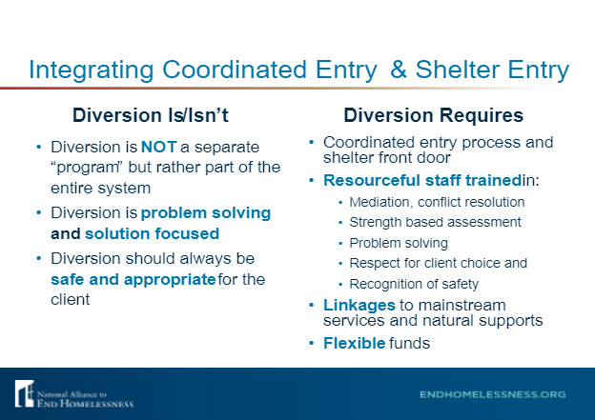
Diversion vs. Homelessness Prevention vs. Eviction Prevention
Notes:
Diversion is different than homelessness prevention and other eviction prevention efforts. It is problem solving and solution focused.

Slide 6
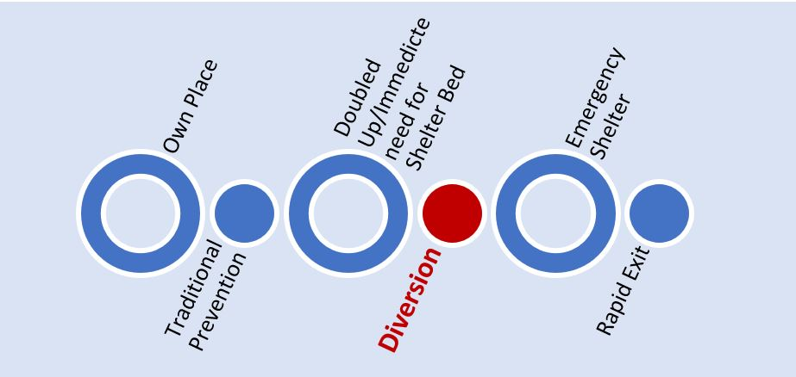
Where Does Diversion Fall in the Homelessness Response System?
Notes:
Here is a useful visualization that shows where diversion can be utilized during someone's housing crisis. Again, this isn't homelessness prevention, but rather it is when a community member is reaching out to emergency housing supports. The case manager or service provider will engage in a problem solving conversation to see if there are other options of supports that a household can explore. For example, do they have a friend or family member they can stay with as they work toward resolving their crisis.

Slide 7

Eligible Participants
Households with an annual income <80% of Area Median Income
Current residents of El Paso County, Colorado
United States Veteran - Determining Veteran Eligbility Status
Household is engaged with one of the following:
  Nonprofit Organization
  Healthcare Provider
  Faith-based Organization
  Educational Institution
  City/County/State Agency
All rehousing options and available resources have been explored
Household lacks sufficient resources that would assist them in their housing crisis
Flex funds have not been received in the last 12 months
Household is seeking assistance to secure or maintain housing
Households moving into a new rental must be signing a lease ready for signatures (not on waitlist)
Noncitizen households or households containing a noncitizen member are eligible for Flex Funds.
Notes:
Eligible participants include households with an annual income that is less than 80% of the area median income. They must be current residents of El Paso County and engaged with an NPO, Healthcare provider, faith-based org, educational institution, or city/council/state agency. All other resources must be explored before an application for flex funds is submitted. A household can receive funding assistance once every 12 months. If they are moving into a new rental, they must be signing a lease ready for signatures, and not on a waitlist. Noncitizen HHs or HHs containing a noncitizen member are eligible for assistance.

Slide 8
Requesting Assistance
Requests for funds must go through an eligible Service Provider who will apply on behalf of the household.
Referring Service Providers must be a member of the PPCoC.
  Agencie that are not members of the PPCoC can complete the following form to apply: https://www.surveymonkey.com/r/WLYRCNF.
  Visit https://www.ppchp.org/homelessness/about-coc for more info and membership application
  PPCoC members represent a variety of groups, including groups that are not CoC-funded and/or do not provide direct services to persons experiencing homelessness.
Eligible Service Providers are limited to submitting one (1) requests per month.
Service Providers can submit a request for Flex Fund assistance by filling out an online form: Veteran Flex Fund Application
Flex funds may only be requested/issued once every 12 months per household.
Requests may combine multiple types of eligible costs but total no more than $2,000 per household.
The Flex Fund Request Form will close each month after 3 approved requests have been received. The form will reopen on the first of the following month.
Notes:
To request assistance, the household must have an eligible service provider submit a request on their behalf. Applications filled out by a client will be automatically denied. Eligible service providers must be a member of the PPCoC. If you are not sure if your agency is a member, please email flexfund@ppchp.org to determine membership status. Otherwise, the agency will need take a few moments to fill out a membership application. Each household is limited to receiving no more than $3500 per request. The application will be closed once approved requests exceed $15000 in a month.

Slide 9
Use With Other Subsidies
If the household is participating in another homeless assistance program (CoC, ESG, etc.), the referring organization must verify on the application that the requested assistance cannot be covered by the other program’s funds to avoid duplication of funding.
Eligible Costs cannot be provided to a household who is receiving the same type of assistance through public sources.
Notes:
To ensure requests are processed efficiently, please thoroughly fill out the application. This includes providing information on all programs the household is participating in. We will need to verify that the request cannot be covered by other program's funds. Costs cannot be provided to a household who is receiving the same type of assistance through public sources.

Slide 10

Eligible Costs
Eviction/Arrears Owed to Previous Landlord (could now be in collections):
Requests will be assessed on a case-by-case basis
Will only be approved if the household has been denied for housing
Fees and Deposits Needed to Apply for and Secure Housing:
Security Deposits up to 2 times the rent
*Application and Administrative Fees
  Requests for application fees will not count as the household's one request allowed per year.
Pet Deposits/Fees
Utility Deposit Activation Fees
Lease or Utility Assistance:
Rental Arrears to PREVENT Eviction or Non-Renewal
Rental Assistance (including Monthly Pet Rent)
  Up to 2-months of rent
Utility Assistance
Renters Insurance
Landlord Mitigation Assistance:
Reimbursement to Landlord/Property Owners for Damages, Repairs, or Vacancy Payments
*Requests for application fees will not count as the household's one request allowed per year.
Notes:
Now we will talk about the types of eligible costs that may be requested. For more details, please refer to the policies and procedures which can be find on our website at www.ppchp.org/flexfunds. All requests will be assessed on a case-by-case basis.
1. Eviction or arrears owed to previous landlord
2. Fees and Deposits needed to apply for and secure housing. Deposit up to two times the rent.
3. Lease or Utility Assistance, up to two months of rent.
4. Landlord Mitigation Assistance

Slide 11
Eligible Costs, Cont.
Gap Funding:
Covers up to $200/month for 6-12-month lease if market rent does not meet payment standards
Rent Increase Due to Lease Renewal:
Covers up to $200/month for 6-12-month lease for households at risk of losing current housing
Hotel/Motel Assistance:
Up to 45-days of hotel/motel assistance
Household must have a signed lease and move-in date established prior to approval
*Transportation:
Items related to one-time, episodic, or regular transportation that can help a client make progress towards ending their homelessness (e.g., car registration, bus passes, etc.)
Fares for the cost of housing navigation to view potential rental options by bus or other transportation services (e.g., taxis, rideshare services, etc.)
*Relocation Assistance:
Bus tickets to return to locales with stable family support
Plane or train tickets
Other transportation fees (e.g., taxis, rideshare services, etc.)
Moving fees to cover the cost of movers
Up to 60 days of storage fees
*We can review additional requests on a case-by-case basis.
Notes:
Gap Funding: Covers up to $200/MTH FOR 6-12 month lease
Rent increase due to lease renewal
Hotel/Motel Assistance: Up to 45 days. HH must have a signed lease and m/i date established
Transportation: Car Registration, bus passes, etc.
Relocation assistance: Bus tickets, plane, train tickets, moving fees, up to 60 days of storage fees.

Slide 12
Eligible Costs, Cont.
*Basic Household Items
Refer to CHP's Flex Fund Policies and Procedures for examples
Critical Documents
Documentation needed to overcome barriers to employment, housing, etc.
  Examples: Driver’s License, State Identification Card, Birth Certificate, Student Records
*Employment and Training:
Items needed for specific employment or job training
  Examples: Uniforms/Footwear/Professional attire, Tools, Personal Protective Equipment, GED Exam/Licensing Fees, Temporary Childcare Costs to Attend Job Interviews
*Other:
ADA home modification options (see Policies and Procedures for examples)
Interpreters to translate housing-related documents/conversations between the landlord and case manager
*We can review additional requests on a case-by-case basis.
Notes:
Basic Household items, again these are all assessed on a case-by-case basis. Please review the policies and procedures for more details on HH items, just keep in mind that not all HH items are a necessity and may not qualify. Pots and pans, bedding, coats, cleaning supplies for example.
Critical Documents: Docs needed to overcome barriers to employment/housing. Birth certs. DLs, etc.
Employment and Training: Uniforms/footwear/professional attire, tools, etc.
Other: ADA modiication options, Interpreters to translate housing-related documents. Please refer to P&P for more examples.

Slide 13
Back-up Documentation/Required Supporting Documents
Review Policies and Procedures for examples of required documentation (dependent upon eligible cost being requested)
Responsibility of Service Provider to submit all required documentation
Backup documents must be emailed to flexfund@ppchp.org within 10 business days of applying.
Service provider will be notified if additional documentation is needed before final approval can be determined.
All vendors (property owners, moving companies, etc.) must complete a W-9 and provide documentation verifying the amounts owed by the household seeking assistance. Statements must be dated within the last 30-days.

Slide 14
Back-up Documentation/Required Supporting Documents Continued…
Requests Involving Payment to Property Owner/Landlord:
  Copy of signed lease
  Documentation of account balances or past due monies owed
  Copy of email correspondence between landlord and service provider confirming rental arrears amount, property address, and landlord’s consent to work with Flex Funds
  Copy of property owner/landlord’s W-9
Requests Involving Other 3rd Party Vendors: (e.g., Hotel/Motel, Utility Company, etc.)
  Vendor’s W-9
  Itemized copies of receipts/transactions for services rendered
  Copy of signed lease if applicable
Requests Involving the Purchase of Items: (e.g., Basic Household Items, ADA Home Modification Options, etc.)
  Itemized copies of receipts/transactions for items purchased
  Vendor's W-9
  Copy of signed lease if applicable

Slide 15
Process of Approval and Communication
The Service Provider will receive a response to the request between 1-3 business days after submitting the application. Response may be:
    Approval Pending Submission of Required Documentation
    Request for Additional Information
    Denial
The Service Provider who submitted the application will be the point of contact with CHP for follow-up and status updates.
CHP will not communicate directly with the household requesting assistance.
All communication, questions, and documentation regarding flex funds must be directed to flexfund@ppchp.org.

Slide 16
Responsibilities of Landlord, Tenant, and Referring Agency
  Landlord:
    Stay in communication with the service provider if conflict with a tenant arises that requires mediation
    Provide necessary documentation related to any funds requested
    Share a copy of the signed lease agreement between landlord and tenant
    Maintain the unit in accordance with Habitability Standards
    Comply with Equal Opportunity/Fair Housing requirements
  Tenant:
    Abide by the rules and guidelines set forth by the landlord outlined in the lease agreement
    Pay utilities and other fees that are not covered by the landlord
    Correct and/or report damages to the rental by a family member or guest in a timely manner acceptable to the landlord
    Notify the referring agency representative if conflict with the landlord occurs that requires mediation
  Referring Agency:
    Submit Flex Fund application on behalf of the household in need of assistance
    Gather and submit all required supporting documentation to flexfund@ppchp.org within 10 business days of the application submission
    Will notify the Housing Navigator Specialist if a conflict arises between the referring agency and landlord that requires mediation

Slide 17
Payments and Reimbursement
Payments are made by CHP directly to the vendor for eligible amounts owed.
CHP cannot directly reimburse a household
  Payments will be mailed to the vendor's address indicated on the vendor's W-9 if a mailed check is the preferred method of payment.
    It is the responsibility of the Service Provider to confirm the vendor's correct address and form of payment accepted (e.g., checks or credit cards only) before payment can be issued.
Reimbursements will be made on behalf of the household and issued to the referring Service Provider if the vendor is not willing to wait for the check to be processed or the Service provider is able to issue payment for eligible costs and request reimbursement from CHP.
  The service provider must provide CHP with a current copy of their agency's W-9 and proof of the payment transaction within ten (10) business days.
  All service providers must fill out a request form and receive approval prior to issuing a payment for which reimbursement will be requested.
CHP is not responsible for late fees accrued if payment is late. It is the Service Provider's responsibility to maintain communication with landlord or vendor on payment.

Slide 18
Homeless Management Information System (HMIS)
Programming for the Flex Funds will be tracked in the Homeless Management Information System (HMIS) for tracking and reporting purposes.
Service Providers who have access to HMIS and submit a request for Flex Funds are required to create or update the head of the household.
Service Providers must adhere to the Colorado HMIS Policies and Procedures listed on ZenDesk: https://cohmis.zendesk.com/hc/en-us/articles/360013991371-Policy-Procedures.
CHP will enter Flex Fund services into HMIS and track household enrollments.
If the Service Provider does not have access to or use HMIS, the person submitting the Flex Fund application is required to follow the steps below before household information can be shared in HMIS:
  Obtain consent from households using the COHMIS Release of Information (ROI): https://cohmis.zendesk.com/hc/en-us/articles/360020127232-COHMIS-Client-Forms
  Consent can include implied, written, or verbal consent, though written consent is preferred. The ROI will be uploaded into HMIS.
If a household refuses consent to enter their information into HMIS, CHP will mark the household records as “Private” in the system.
A VI-SPDAT does not need to be completed for households seeking flex fund assisteance.

Slide 19
Veteran Flex Fund Flow Chart
Service Provider Submits a Flex Fund Application
Flex Fund Manager Reviews Application and Responds to Service Provider (between 1-3 business days)
Service Provider Receives Final Approval Once All Required Documentation is Processed
Payment or Reimbursement Issued By CHP
Service Provider Submits Required Documentation to flexfund@ppchp.org (within 10 business days of application submission)
Flex Fund Manager Reviews Documentation and Notifies Service Providers If Additional Documentation Is Needed

Slide 20
Flex Fund Forms and Contact Information
Heather Brinker and Angela Roberts:
  Flex Fund Managers
Email:
  flexfund@ppchp.org
Funding Request Form: Veteran Flex Fund Application
PPCoC Membership Application:
  https://www.surveymonkey.com/r/WLYRCNF
Flex Fund Website: https://www.ppchp.org/veteran-flex-fund/

