Slide 1
Fall 2023 Membership Meeting
PPCoC
Governing Board -
October 27, 2023

Slide 2
Membership Meeting Agenda
Welcome – Call to order
PPCoC Governing Board roster
Vote in new Governing Board Members
Reporting on CoC Activities
PPCoC Strategic Plan & Performance update
Update on CHP role
Point in Time Survey
Q & A
Call for New Members

Slide 3
PPCoC Governing Board Roster - 2023
Alison Gerbig, LSW, Program Manager, Rocky Mountain Human Services, Homes for All Veterans program -SSVF.
Andy Barton, President & CEO, Catholic Charities
Anne Markley, CEO, TESSA
Anne Beer, Director of Health Equity, Peak Vista Community Health Centers
Crystal Karr*, Homeless Prevention and Response Coordinator, City of Colorado Springs
Eric Leonard*, Housing Analyst, El Paso County Economic Development
Haley Chapin, Executive Director, Tri-Lakes Cares
Jansen Howard, Street Outreach Program Manager, Homeward Pikes Peak
Kat Lilley-Blair, Office Volunteer, NAMI
Karla Colonnieves*, Homeless Programs Specialist, State Housing Vouchers, Office of Homeless Initiatives
Kayla Rockhold, LCSW, Social Worker, Pikes Peak Library District
Kristy Milligan, CEO, Westside Cares
Marissa Shoback, Finance Director, Colorado Statewide Parent Coalition
Paul Spencer*, Deputy Director, Colorado Springs Housing Authority
Terry Anderson, Chief Operating Officer, Springs Rescue Mission
Velda Baker, Faith Community Nurse, Penrose-St. Francis Hospital
*Indicates ex-officio status

Slide 4
Thank you for your dedicated service and commitment to ending homelessness in EPC!
Departing PPCoC Governing Board members
Michael Malone, Regional Director, Weidner Apartments Homes
Stephanie Johnson, Associate Professor, College of Education, University of the Southwest
Chris Garvin, Deputy Executive Director, El Paso County Department of Human Services

Slide 5
PPCoC Governing Board candidates
Mary Beringer, Community Member
Jamie Brown, Senior Program Officer, Colorado Springs Health Foundation
Doug Hanson, Captain, Salvation Army, Colorado Springs
Stacie Kwitek, Executive Director, El Paso County Department of Human Services

Slide 6
Mary Beringer
Mary Beringer became homeless after a career change attempt in 2010. She is now housed in Section 8 housing and retired from her career as a licensed cosmetologist and a certified pharmacy technician.

Slide 7
Jamie Brown
Jamie Brown currently serves as the Senior Program Officer at the Colorado Springs Health Foundation, a health funder providing grants in El Paso and Teller Counties in Colorado. She brings more than 20 years of experience in the foundation and non-profit sectors, primarily in philanthropy overseeing grantmaking, programs, and donor and funded partner engagement. Jamie’s experience includes being on the start-upside of two different foundations, designing and building grantmaking systems while cultivating relationships with communities served by these philanthropic dollars. Jamie has served on numerous boards and committees over the years. Currently, she is active in suicide prevention collaboratives. Jamie holds a Bachelor of Art in Psychology and Political Science from Colorado College and a Master’s in Marriage and Family Therapy from Regis University.

Slide 8
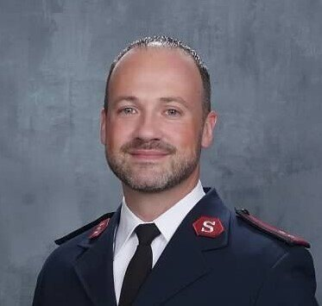
Captain Doug Hanson
Captain Doug Hanson was commissioned officer in The Salvation Army in June of 2012. Since then, The Salvation Army has moved them to Cheyenne, WY for 4 years., to Stockton, CA for 3 years, and have served in Colorado Springs, CO since June of 2019. In Captain Doug’s time as an officer, he has focused on increasing services to better serve others in all 3 appointments. While in Colorado Springs the budget has more than doubled to over $9 Million with a huge increase in client success across programs. A Salvation Army officer is a pastor and an Executive Director meaning that Capt. Doug most Sundays is preaching and throughout the week finding ways to connect program guests and church members to Jesus Christ.

Slide 9
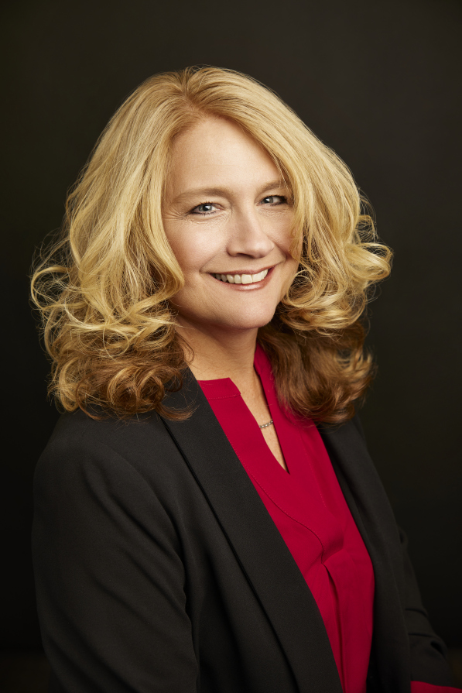
Stacie Kwitek
Stacie Kwitek has served as the Executive Director of El Paso County Department of Human Services -- the busiest human services department by volume in Colorado -- since August 2021. During her tenure, the EPCDHS she has decreased staff vacancy rates, launched a new division focusing on quality assurance and staff development, and enhanced key community partnerships.
Prior to El Paso County, Stacie served in Fremont County for almost 17 years in several positions including Director of Fremont County Department, Child Welfare caseworker, supervisor, and manager, and also as part of Adult Protection and Options for Long Term Care teams. As Director in Fremont County, Stacie became an integral part of the community collaboration to end homelessness. She is proud to have been part of the Fremont County Built for Zero team who was able to reach Functional Zero for Veterans in 2021.

Slide 10
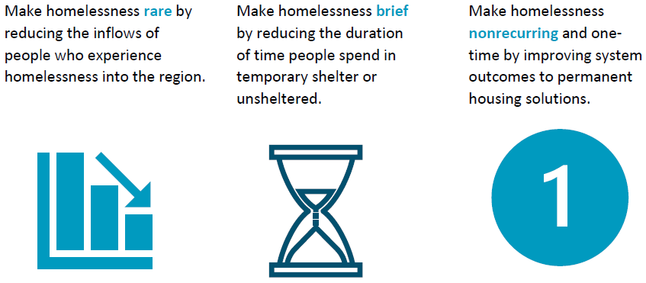
PPCoC 3-Year Strategic Plan - Goals

Slide 11
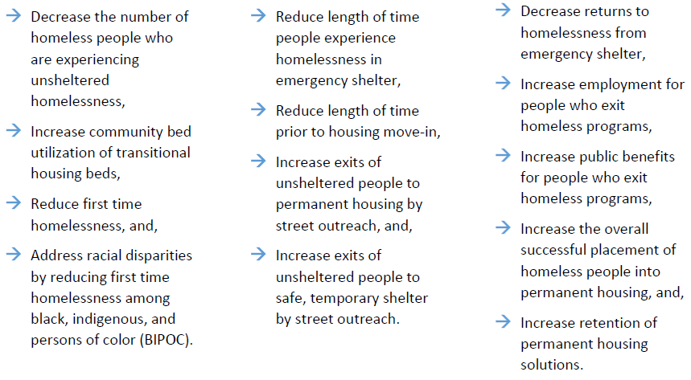
Rare Brief One-time
Notes:
Homeless Diversion training

Slide 12
Goal 1: Make homelessness rare by reducing the inflows of people who experience homelessness into the region.
Objective 1.1: Decrease the unsheltered homeless count for the Point in Time by 10%.
Objective 1.2: Achieve bed utilization for transitional housing at 90% or greater.
Objective 1.3: Achieve a 15% reduction in First Time homelessness.
Objective 1.4: Reduce first time homelessness for black, indigenous, and people of color (BIPOC) by 25%.
Goal 2: Make homelessness brief by reducing the duration of time people spend in temporary shelter or unsheltered.
Objective 2.1: Reduce length of time persons are active in ES programs to fewer than 60-days.
Objective 2.2: Reduce length of time prior to housing move-in to fewer than 120 median days.
Objective 2.3: Increase exits to permanent housing from street outreach by 5%.
Objective 2.4: Increase exits into temporary/Institutions from street outreach by 10%.
Goal 3: Make homelessness nonrecurring and one-time by improving system outcomes to permanent housing solutions.
Objective 3.1: Decrease homeless returns to fewer than 20% within six-months of stays from emergency shelter.
Objective 3.2: Increase cash earned benefits for system leavers to more than 20% for all leavers.
Objective 3.3: Increase non-cash benefits for system leavers to more than 40% for all leavers.
Objective 3.4: Increase successful exit placements into permanent housing to 20% of all exits.
Objective 3.5: Achieve retention of permanent housing at 90% or greater.

Slide 14
Notes:
Very positive trend
We exceeded our goal of having fewer first-time homelessness
First time we’ve exceeded our goal
A dramatic reduction from 2022 SPM
Breakdown means that fewer people were homeless for the first-time last year

Slide 15
Notes:
Positive trend
We nearly matched our goal of reducing length of time in emergency shelter
Back to baseline, almost at our goal
A dramatic reduction from 2022 SPM
Breakdown means that people stayed in emergency shelter for less time

Slide 16
Notes:
Positive trend
We remain above our goal of 120-days to move-in
Lowest median days we have reported, moving towards our goal, closest we’ve been so far
A small reduction from 2022 SPM
Breakdown means that people are reducing the length of time before moving into housing

Slide 17
Notes:
Extremely positive trend
We dramatically exceeded our goal
Highest percentage of exits who increased earned cash benefits
A tremendous increase from 2022 SPM
Breakdown means that more people left homelessness with increased cash earned benefits (jobs)

Slide 18
Notes:
Negative trend
We moved in the wrong direction from our goal and from our baseline level
Second lowest percentage since 2021, did not move towards our goal
A significant decrease from 2022 SPM
Breakdown means that fewer people left homelessness with unearned benefits (public assistance)

Slide 19
Notes:
Very positive trend
We back to high retention of permanent housing
Exceeded our strategic goal
A significant increase from 2022 SPM, 2022 was an anomaly because the VA exited all HUD-VASH out of HMIS, which dramatically decreased our exit retention because they were not managing records
Breakdown means that more people retained housing when they left permanent housing

Slide 20
Q and A

Slide 21
Call for New Members

