Slide 1
Spring 2023 Membership Meeting
PPCoC
Governing Board -
June 2, 2023

Slide 2
Membership Meeting Agenda
Welcome – Call to order
PPCoC Strategic Plan updates
Colorado Homelessness Response presentation
Kristin Toombs, Director of Homeless Initiatives, Division of Housing, Department of Local Affairs
Q & A
Call for New Members

Slide 3
Continuum of Care Purpose
Promote communitywide commitment to the goal of ending homelessness;
Provide funding for efforts to quickly rehouse homeless individuals and families while minimizing the trauma and dislocation caused to homeless individuals, families, and communities by homelessness;
Promote access to and effective utilization of mainstream programs by homeless individuals and families; and
Optimize self-sufficiency among individuals and families experiencing homelessness
Notes:
The Continuum of Care is governed by the Code of Federal Regulations: 24 CFR Part 578 Continuum of Care Program

Slide 4
PPCoC Governing Board Roster - 2023
Alison Gerbig, LSW, Program Manager, Rocky Mountain Human Services, Homes for All Veterans program -SSVF.
Andy Barton, President & CEO, Catholic Charities
Anne Markley, CEO, TESSA
Anne Beer, Retired, former Director of Health Equity, Peak Vista Community Health Centers
Christopher Garvin, Deputy Executive Director, El Paso County Department of Human Services
Crystal Karr*, Homeless Prevention and Response Coordinator, City of Colorado Springs
Haley Chapin, Executive Director, Tri-Lakes Cares
Jansen Howard, Street Outreach Program Manager, Homeward Pikes Peak
Karla Colonnieves*, Homeless Programs Specialist, State Housing Vouchers, Office of Homeless Initiatives
Kat Lilley-Blair, Office Manager, NAMI
Kayla Rockhold, LCSW, Social Worker, Pikes Peak Library District
Kristy Milligan, CEO, Westside Cares
Marissa Shoback, Finance Director, Colorado Statewide Parent Coalition
Michael Malone, Regional Director, Weidner Apartments Homes
Paul Spencer*, Deputy Director, Colorado Springs Housing Authority
Randi Davis*, Housing Analyst, El Paso County Economic Development
Stephanie Johnson, Associate Professor, College of Education, University of the Southwest
Terry Anderson, Chief Operating Officer, Springs Rescue Mission
Velda Baker, Faith Community Nurse, Penrose-St. Francis Hospital
*indicates ex-officio status

Slide 5
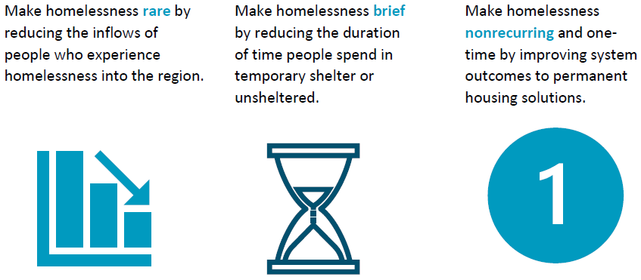
PPCoC 3-Year Strategic Plan - Goals

Slide 6
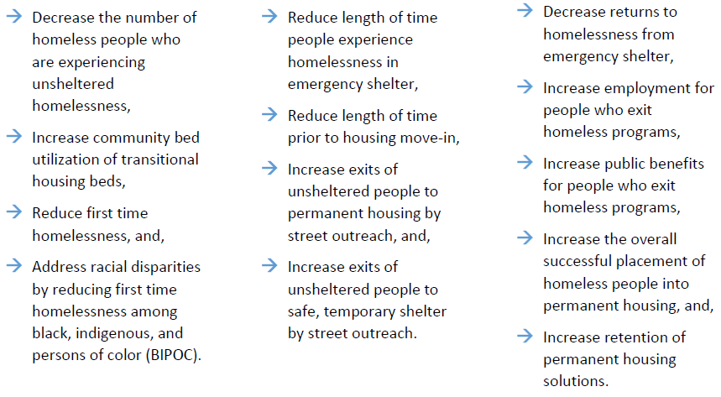
Rare Brief One-time
Notes:
Homeless Diversion training

Slide 14
Presentation from Kristin Toombs
Director – Office of Homeless Initiatives
Colorado Department of Local Affairs
Division of Housing

Slide 15
Q and A

Slide 16
Call for New Members

