Slide 1
Pikes Peak Continuum of Care
Fall Membership Meeting
November 20, 2020

Slide 2
Welcome Governing Board Elections Report on PPCOC Activities System performance measures National Alliance to End Homelessness System Design Clinic Strategic Plan Q & A Call for New Members
AGENDA

Slide 3
2020 PPCOC Board Roster
Alison Gerbig – Rocky Mountain Human Services
Ann-Marie Manning- Pikes Peak Community College
Andy Barton – Catholic Charities
*Andy Phelps – City of Colorado Springs
Beth Roalstad - Homeward Pikes Peak (term ends 12/20)
*Chad Wright – Colorado Springs Housing Authority
*Christopher Garvin – El Paso County Dept. of Human Services
*Crystal LaTier– El Paso County Housing Authority
Haley Chapin – Tri Lakes Cares
Jeff Cook – Springs Rescue Mission
John Spears – Pikes Peak Library District
Kat Blair – Lilley – Family Promise
Kimberley Sherwood – Kimberley Sherwood Consulting
Laura Nelson – Apartment Association of Southern Colorado
Noreen Landis-Tyson - CPD
Shawna Kemppainen – Urban Peak Colorado Springs
*Steve Posey– City of Colorado Springs Community Development
*Indicates Ex-Officio Status

Slide 4
PPCoC Governing Board Election Process
PPCoC Board Members will be elected by the Voting Members at the Fall Membership meeting and seated in January annually.
Only 1 representative per organization should submit votes
Please list name and organization when signing into PollEV
Process is anonymous
Candidate is elected as long as simple majority is in favor
Pollev.com/tarynbailey943

Slide 5
Pikes Peak Continuum of Care
2021 Governing Board Candidates

Slide 6
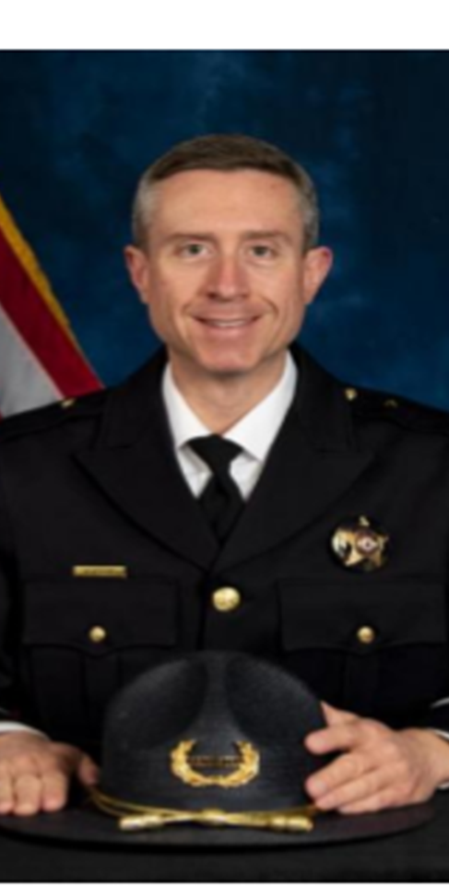
Commander Andy Prehm– El Paso County Sherriff’s Office, detention Division
Commander Prehm began his career with the El Paso County Sheriff’s Office in 2002. He was promoted to the rank of Sergeant in 2007, Lieutenant in 2012 and Commander in 2018. He has been assigned to all three bureaus, holding assignments in CJC Floor Security, Intake and Release, Court and Transport, Detentions Programs, Research and Planning, Background Investigations, Public Information, Administrative Services, Personnel and Special Operations. In 2016, Commander Prehm was selected as a Police Executive Fellow by the Federal Bureau of Investigation where he was assigned to the Executive Staff of the Assistant Director for the Criminal Investigative Division at FBI Headquarters. He has held additional duties on the Mounted Unit, Special Response Team, GangNet, and as a CVSA examiner.
Commander Prehm is passionate about the topic of juvenile justice, serving on the 4th Judicial District’s Juvenile Services Planning Committee and the Colorado Youth Detention Continuum Board.
Commander Prehm is an instructor for the International Association of Chiefs of Police – Leadership in Police Organizations program; as well as an academy academics instructor. He is an alumnus of the Leadership Pikes Peak Signature Program. Commander Prehm holds a Bachelor of Science in Political Science from the University of Southern Colorado and a Master of Arts in Educational Leadership and Policy Studies from the University of Northern Colorado.

Slide 7
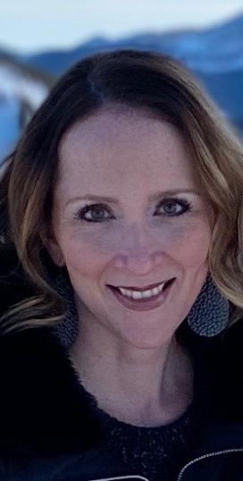
Anne Markley– TESSA
Ms. Markley received her Bachelor of Science in Human Development and Family Studies from Colorado State University and her Master’s in Business Administration from University of Colorado. She has served for the past 8 years in a volunteer capacity with TESSA, most recently serving the past two years as the President of the Board of Directors. Ms. Markley is an active member of the non-profit community in Colorado Springs and has a passion for the mission of TESSA. Prior to committing herself to the work of TESSA, Ms. Markley worked in marketing and advertising, specifically focused on non-profits.

Slide 8
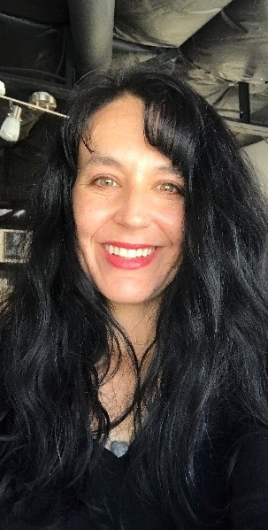
Kristy Milligan– West Side Cares
Kristy Milligan gratefully leads Westside CARES, in concert with its board, member faith communities, and paid and volunteer staff to serve more than 22,000 neighbors in need annually on the west side of El Paso County. She brings 20 years of experience in the nonprofit sector to her role, and she is deeply passionate about challenges impacting people experiencing poverty and homelessness, from social stigma to unnavigable bureaucracies to affordable housing. In addition to her many roles as CEO, Milligan also works directly with neighbors experiencing poverty and homelessness at Westside CARES. She is a Colorado Springs native, a runner, a dog-lover, and a believer in the innate dignity of every human and the power of beloved community to heal.

Slide 9
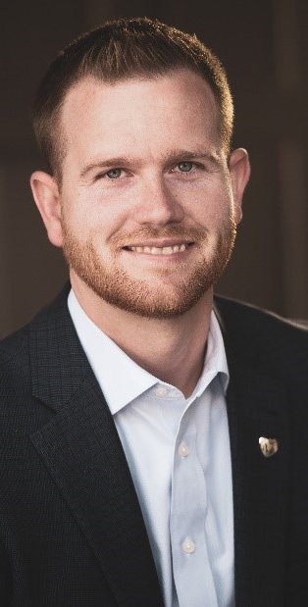
Michael Moyer– Weidner Apartment homes
Michael is currently the Colorado Regional Director for Weidner Apartment Homes where he oversees the operation of 18 apartment communities, totaling over 2,900 residential units across Colorado Springs. He has been a part of the apartment industry in Colorado Springs for 10 years and loves the unique challenges this industry brings. He strongly believes that success comes from empowering his teams to provide exceptional customer service by truly caring for their residents.
Michael received his B.A. in Communication Studies from Eastern University. He also holds the designation of Certified Apartment Manager with the National Apartment Association and serves on the board for the Apartment Association of Southern Colorado.
In his free time Michael enjoys spending time with his wife, Elizabeth, and two kids exploring downtown Colorado Springs and the outdoors of Colorado.

Slide 10
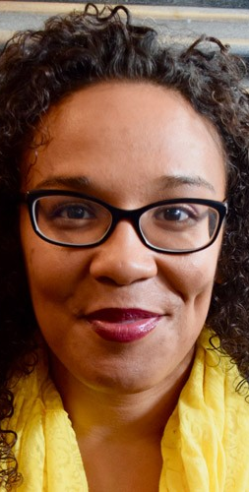
Patience Kabwasa– Colorado Springs Food Rescue
Patience Kabwasa’s heart is to work and create a more socially just, healthy and racially equitable Colorado Springs through creating better access to and knowledge around healthy foods. She has served on Colorado Springs Food Rescue’s board of directors from 2015-2016, and joined as the Director of Programs in 2016.
Additional community involvement includes serving as a parent advisor through the Black Alliance for Educational Options (2007-2008), garden ministry coordinator through Relevant Word Christian Cultural Center (2008-present), participating in the African-American Youth Leadership Conference (2011-2012), and a member of the Colorado Transforming Safety Local Planning Team (2018-present), and a member of the Colorado Springs District 11 Policy Committee (2018-present). She is also a weekly columnist for the Colorado Springs Independent, delivering original insight into local race relations, health equity, the criminal justice system, and education.
She has given lectures on the topic of food equity at the Pikes Peak Food Shed Forum, Colorado College, University of Colorado - Colorado Springs, & the Forward Food Summit, is a 2018 graduate of the Center for Creative Leadership Strategic Leader training, Kabwasa is a 2018 recipient of the prestigious Live Well Colorado Community Impact Champion award and is a 2019 Aspen Ideas Health Scholar. She is also a mother of 3 musically and engineeringly gifted passionate teenagers.

Slide 11
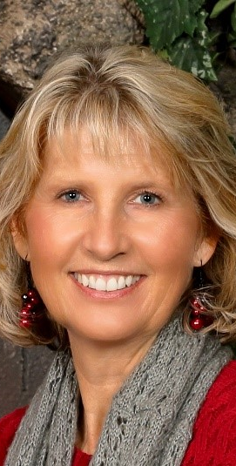
Stephanie Johnson– Mckinney Vento Liaison
I am an educator and currently work for Lewis Palmer School District as a Language, Culture and Equity program coordinator. I am also the school district representative for McKinney–Vento homeless education. Additionally, I have worked at the university level for over 24 years teaching and designing curriculum for a variety of subjects ranging from human resource development to a variety of psychology courses. I am retired Air Force after 20 years on active duty. Much of my time (9 years) was spent teaching at the US Air Force Academy in the Department of Behavioral Sciences and Leadership. The other 11 years were spent as a human resources officer. I currently teach as an adjunct faculty member for American Public University.
My academic degrees are a PhD in Education and Human Resource Studies, a Master of Arts in Human Behavior and another Master of Arts in Counseling Psychology. I also have a graduate certificate in Women's Studies. I am married to my hubby of 35 years and have three adult children plus a daughter-in-law. I value volunteering and have dedicated time to Pikes Peak Citizens for Life, local churches, my homeowner’s association and Tri-Lakes Cares. I love being in the outdoors of Colorful Colorado! My hobbies include reading, traveling, hiking and kayaking.

Slide 12
PPCoC Election Results
Taryn Bailey, Director of Communication and Partnerships, CHP

Slide 13
PPCoC Activity Report
System performance measures
National Alliance to End Homelessness System Design Clinic
Strategic Plan

Slide 14
System Performance Measures Evan Caster, Manager of Homeless Initiatives

Slide 19
National Alliance to End Homelessness (NAEH) System Design Clinic
The System Design Clinic is a process for Continuums of Care to make changes in their homeless response system including implementing best practice policies and procedures, and right sizing their system to ensure that homelessness is rare, brief, and one time.
The Alliance will collect and analyze a comprehensive set of data elements that describe our community’s homeless population, our system’s ability to move people to permanent housing quickly, and our system’s cost-efficiency.
They will also qualitatively analyze our system by surveying community leaders, providers including executive directors and front-line staff, and people experiencing homelessness. The qualitative analysis will also involve reviewing planning and operation documents, and evaluation reports.
The Alliance will guide participants in creating action plans to achieve our priorities and, following the Clinic, support implementation effort

Slide 20
Strategic Planning
January – February:
NAEH System Design Clinic
March:
Board Strategic Planning Meeting
April:
Plan finalized & presented at Spring Membership Meeting

Slide 21
Q and A

Slide 22
Call for New Members
Andy Barton

