Slide 1
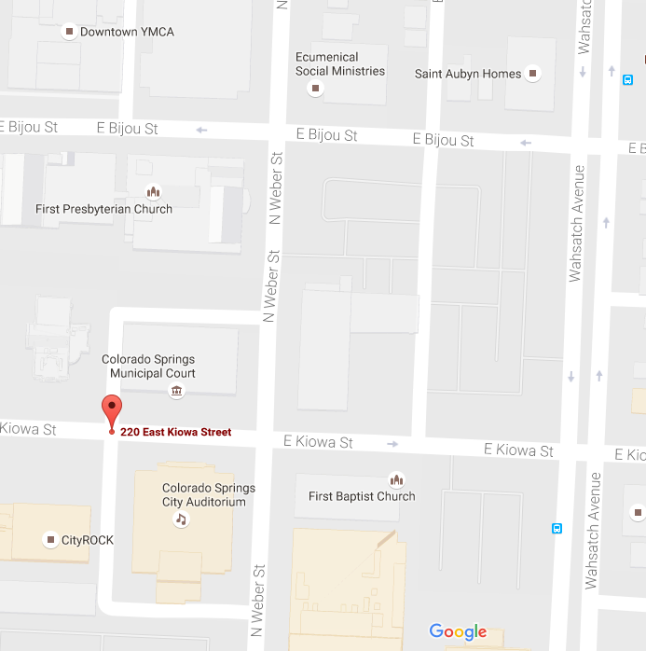
15 October 2019 Stand Down Parking
YMCA Parking on roof
30 free slots
City Parking Garage
Get ticket $6 day
Stand Down
1st Baptist Lot 50 free Slots
just not against the fence
And not on first row

