Slide 1
Pikes Peak Continuum of Care
Bi-Annual Membership Meeting
Special Guest:
Claas Ehlers, CEO Family Promise
November 16, 2018

Slide 2

Agenda
  PPCoC Structure & Function
  Plans to End Homelessness
  Review of 2018 Community Data on Homelessness
  2018 CoC Funding Competition
  Membership Voting
  Key Note Speaker –Claas Ehlers, Family Promise
  Q&A with Membership
  Closing Comments/Call to Action
Notes:
Aimee- GB and CHP Staff stand as a group; welcome audience by categories: community, businesses, providers, faith groups, etc.
Incorporate National Hunger & Homeless Awareness Week (Nov 10-18) into welcome

Slide 3
PPCoC Structure and function
Purpose of the PPCoC: Promote community commitment to the goal of ending homelessness; monitor the effectiveness of programs; collect and report on data; promote strategic use of resources to address homelessness
Role and Responsibilities of the Membership
  Decision-Making Body: Adopt/amend charter, appoint Governing Board
  Inclusive: Includes citizens, service users, businesses, funders, service providers, government, education, and health care
  Support- Through active participation and committee work with the CoC
Governing Board of the Membership
  Guide on-going administrative functions of the CoC
  Plan & support implementation of CoC strategies
  Convene membership meetings at least 2x/year; recruit new members
Notes:
Aimee:
Purpose: (from hudexchange)
The CoC Program is designed to assist individuals (including unaccompanied youth) and families experiencing homelessness and to provide the services needed to help such individuals move into transitional and permanent housing, with the goal of long-term stability. More broadly, the program is designed to promote community-wide planning and strategic use of resources to address homelessness; improve coordination and integration with mainstream resources and other p
programs targeted to people experiencing homelessness; improve data collection and performance measurement; and allow each community to tailor its program to the particular strengths and challenges within that community.
When establishing a CoC, communities must bear in mind that CoCs are designed to: • Promote a community-wide commitment to the goal of ending homelessness • Provide funding for efforts for rapidly re-housing homeless individuals and families • Promote access to and effective use of mainstream programs • Optimize self-sufficiency among individuals and families experiencing homelessness
Definition of membership:
The CoC seeks to be as inclusive as possible to fully reflect the community’s commitment to fighting homelessness. Members must have expressed interest or knowledge in addressing the issues of homelessness.

Slide 4
Plans to end homelessness
VISION: By 2026, our community will have a durable system of places and programs to ensure that all people facing homelessness have access to housing and the supportive services to sustain their quality of life.
Notes:
With HUD funding of approximately $2.5 M annually
We promote a community wide commitment to end homelessness
We utilize funding to quickly re-house families
We work with clients to optimize their self-sufficiency
We are guided by policy and plans at the national level:
2010 Opening Doors: Federal Plan to Prevent & End Homelessness
2012 HEARTH Act Rules Published
2015 Opening Doors (amended)
2018 Home, Together: The Federal Strategic Plan to Prevent & End Homelessness

Slide 5
Plans to end homelessness:
Local strategy and goals

Slide 6
Community Plans:
CoC Consultation Role
CoC Role – Consult with local government regarding allocation of grant funds, and reporting on, and evaluating the performance of sub-/recipient organizations
Current Community Plans in Draft
HelpCOS (City)
Annual Plan (City)
Role of Membership, Service Providers, & Community – Dialogue and advocate!

Slide 7
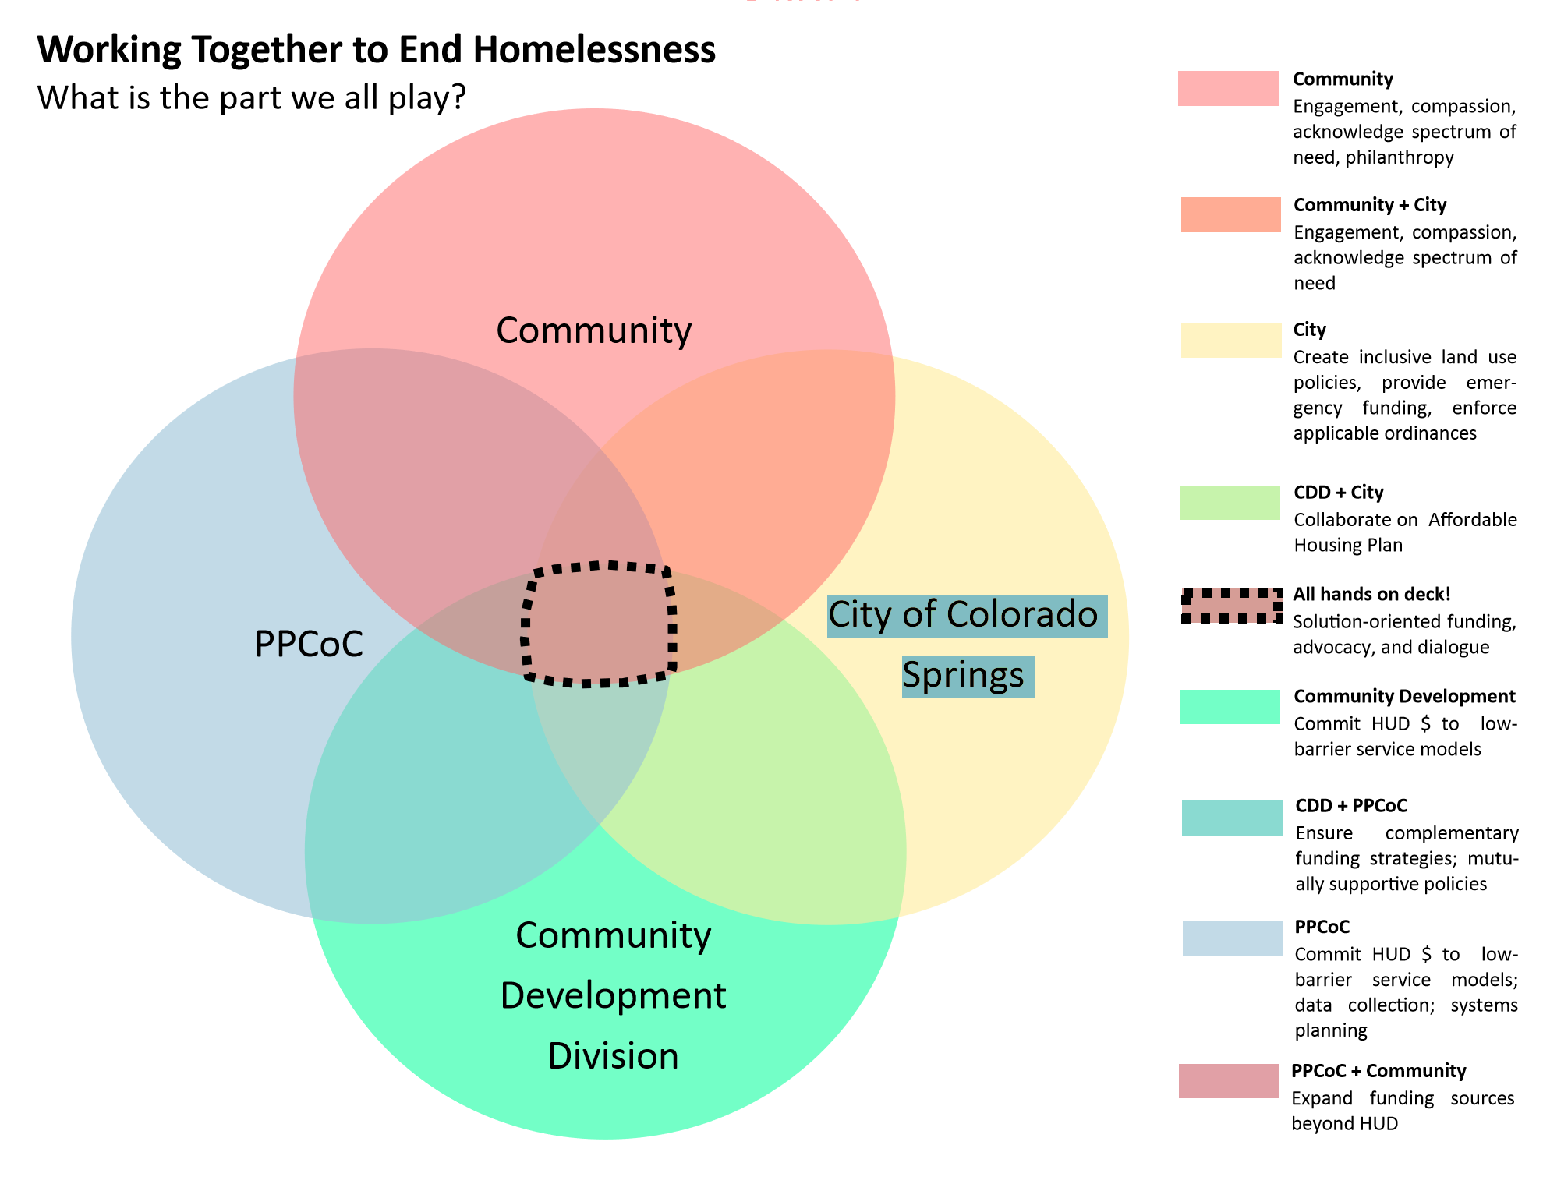
City/CoC Relationship

Slide 8
Coc community report - 2018
Overview:
Purpose and Process of Data Reporting
Key Reports:
Point in Time Survey
Housing Inventory

Slide 9
Point-in-time survey results 2013 -2018
Notes:
Point In Time Highlights – HUD count:
The total number of persons counted in 2018 increased 9.6% from 1415 to 1551 . (Not including people in supportive housing programs)
There was an 11% increase in the number of people who were unsheltered. This year that was 513 of our neighbors compared with 457 last year. So 56 more people were living unsheltered on that one night = a snapshot of the most vulnerable in our community.
Too early to make many inferences from the data, but it is likely relevant that …
There was brand new Street Outreach team with additional volunteers and technology helping to locate “unsheltered persons”
Of the 513 unsheltered persons at the time of PIT may not have been in a shelter/housing resource because the available resources may have been for a special sub-population – Veterans, victims of DV, youth, medically fragile, etc.)

Slide 10
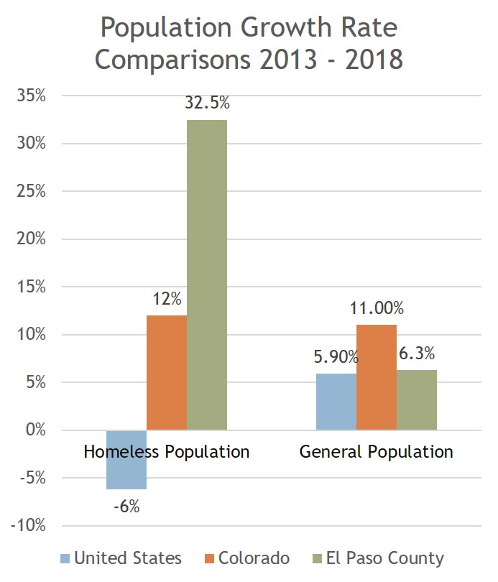
General Population growth rate vs.
Homeless population growth rate

Slide 11
Colorado springs median rent vs.
Hud fair market rate vouchers
Notes:
https://public.tableau.com/profile/apascual#!/vizhome/OpioidsandPoverty/OpioidsandPoverty

Slide 12
CoC Community Report – 2018
Recommendations
Work
The community must work deliberately to add housing units and move people out of shelters and transitional programs into stable housing
Expand
Expand community outreach programs serving unsheltered adults
Magnify
Magnify efforts to engage and incentivize landlords to house Veterans experiencing homelessness
Expand
Expand efforts to house families with children
Increase
Increase HMIS participation locally
Address
Take steps to address racial disparities in rates of homelessness and equity of service provision
Notes:
Access to safe, supportive, accessible, and affordable housing remains the most significant challenge to residents experiencing or at risk of homelessness. This will require political will and investment.
Robust outreach reduces the likelihood of overlooking individuals experiencing homelessness who are most in need and brings services directly to people who might not otherwise seek services. Community outreach programs can be supported by specialized law enforcement such as the CSPD Homeless Outreach Team, but law enforcement teams should not be expanded in lieu of community outreach that connects people to services rather than enforces laws.
Best practices for housing Veterans include outreach to landlords, providing a point of contact when issues arise with tenants, and ensuring any damage is repaired and lost rental income replaced. In the meantime, more outreach should be targeted to Veterans
living unsheltered to identify their shelter and service needs and connect them with suitable programs to better ensure their health and safety while waiting for stable housing.
No child should face homelessness ever. Opening Doors: Federal Strategic Plan to Prevent and End Homelessness set the goal to end family homelessness by 2020. This will require better strategies for identifying all families experiencing homelessness, using prevention strategies whenever possible, and otherwise providing access to safe, temporary shelter and housing until a family can be connected to permanent housing. Rapid rehousing programs rapidly connect families and individuals experiencing homelessness to permanent housing through time-limited financial assistance and targeted supportive services and have demonstrated success in higher rates of
permanent housing placement and lower rates of returns to homelessness. Rapid-rehousing is underutilized in El Paso
County and should be expanded.
Data helps communities dispel myths about homelessness and stay focused on effective interventions. The HMIS is the most comprehensive source of information on homelessness in a community. Many housing programs are not required to participate in HMIS and choose not to participate, which prevents communities from understanding the true nature and extent of homelessness in their jurisdictions and from fully participating in the aggregation of data to better inform homeless policy at the federal and state levels. Finding strategies to encourage robust participation in this system will help improve the quality of interventions.
Racial disparities in experiences of homelessness in El Paso County are clear and persistent. The U.S. Interagency Council on Homelessness (USICH) and federal partners are challenging Continuums of Care across the country to assess and address racial
disparities. USICH recommends better data collection and analysis to understand the scope of racial disparities, identifying policies that perpetuate racial disparities, and training to build a shared understanding of the scope and drivers of racial disparities so they can be addressed. Continuums of Care cannot alone solve all of the dynamics and forces that create disparities. Change will require significant community-wide shifts that will take time and lasting commitment.

Slide 13
2018 CoC Funding competition
HUD CoC Priorities and Application Points
22 Projects were submitted for consideration from 9 applicants.
Tier 1 and Tier 2 Ranking
Take-Aways:
  Application Gaps
  Need for monitoring and capacity building
  Focus for 2019

Slide 14
Membership Voting
Governing Board Elections
Recommended Changes to PPCoC Charter

Slide 15
Governing Board Election Process
  Membership votes on the Governing Board annually
  PPCoC Governing Board (GB) comprised of 13-21 members
  City of Colorado Springs, El Paso County, and Colorado Springs Housing Authority representatives serve the GB in ex-officio capacity
  GB members may serve up to two, 3-year terms

Slide 16
2018 Governing board roster
Beth Roalstad - Homeward Pikes Peak
Greg Morris - Ascending to Health
Kimberley Sherwood - Third Sector Group
Jennifer Polk - Catholic Charities of Central Colorado
Aimee Cox – Community Health Partnership
*Andy Phelps – City of Colorado Springs
*Joanna Crosby– City of Colorado Springs Community Dev.
*Chad Wright – Colorado Springs Housing Authority
*Christopher Garvin – El Paso County Dept. of Human Services
*DeAnne McCann – El Paso County Housing Authority
Jacque Franklin – First Congregational Church
John Spears – Pikes Peak Library District
Laura Nelson – Apartment Association of Southern Colorado
Shawna Kemppainen – Urban Peak Colorado Springs
SherryLynn Boyles – TESSA
*Indicates Ex-Officio Status

Slide 17
Pikes Peak continuum of care
2019 Governing Board Candidates

Slide 18
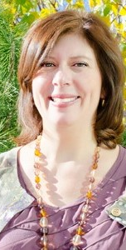
AlIson gerbig–
Rocky mountain Human services
As a Colorado Springs native, I grew up volunteering in our community supporting minority and vulnerable individuals to include advocating for several extended family and friends who experienced homelessness, addiction, and mental illness. My local work experience includes Partners in Housing, TESSA, and now managing a VA-funded program working to end veteran homelessness. I have dedicated my work efforts to ending homelessness and developing best practices for those who are vulnerable and at-risk. I volunteer on the Strategic Planning Task Force Committee and lead the monthly Community Advisory Council of Veteran Homelessness (CACVH) work group. I appreciate and welcome the opportunity to increase my role as an official ambassador for the community and advocate for the success of the CoC.

Slide 19

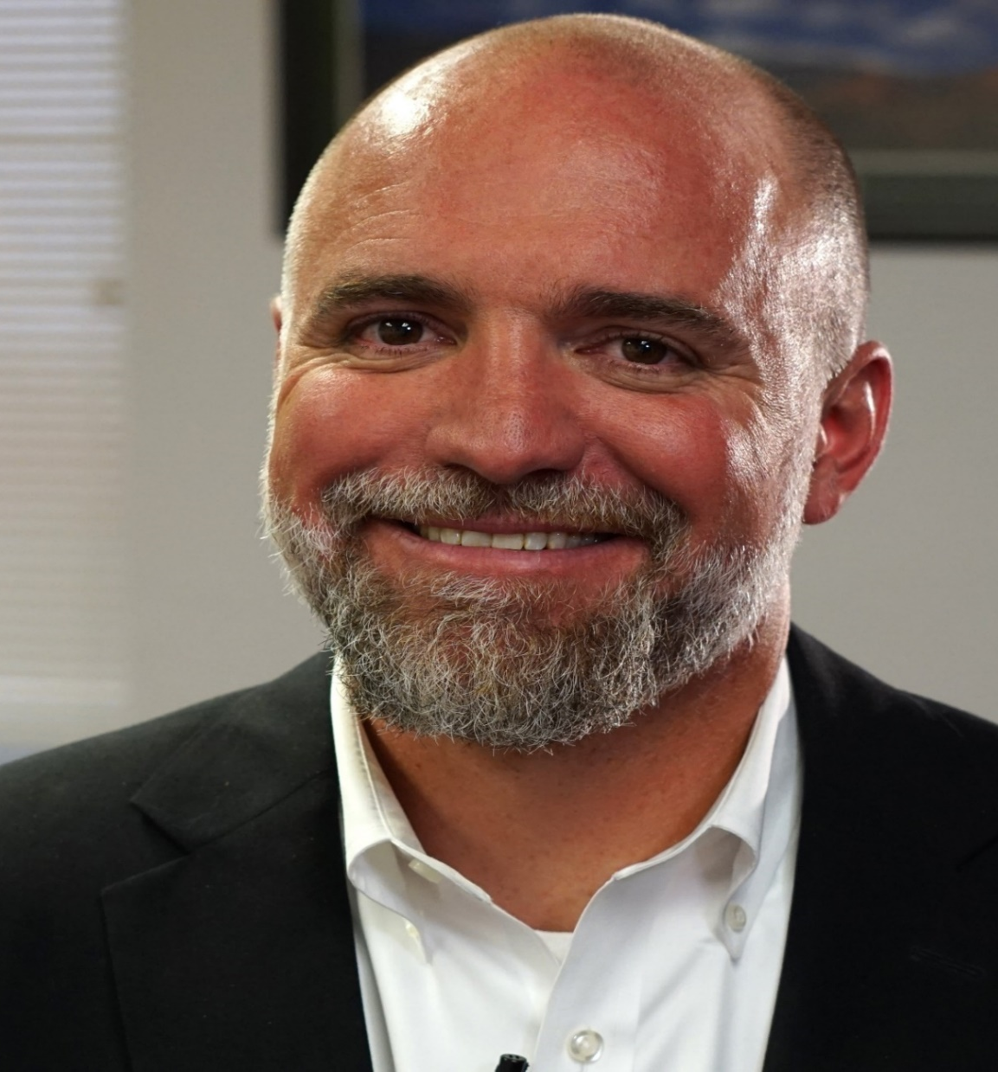
Andy barton –
Catholic charities
My commitment to the board of the Continuum of Care is to be an active and thoughtful participant, with an eye to solutions rather than problems. I will work to maximize collaboration for the good of those who experience homelessness and for the broader community of stakeholders, understanding that the common good should be the ultimate goal. Finally, I will work to be well informed around the issues and to engage the broader community conversation in a manner that builds upon the confidence and trust that the CoC has earned to this point in its existence.

Slide 20
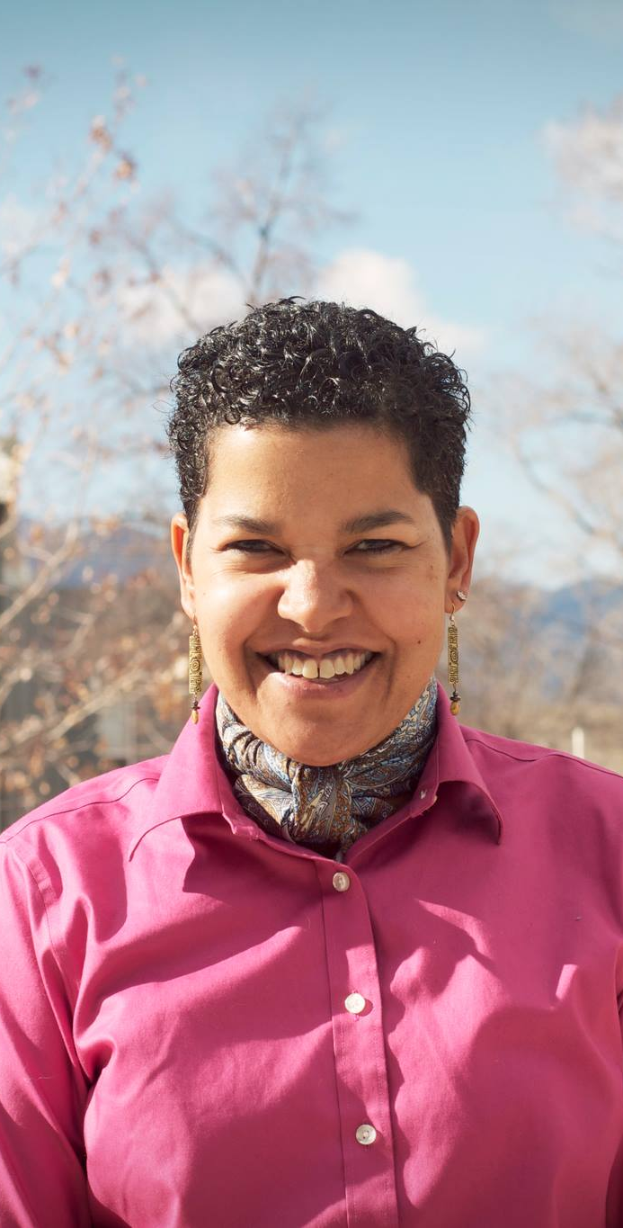
Ann-Marie Manning–
Pikes Peak
Community college
I have been working on housing issues at Pikes Peak Community College for one year and it is important to me to do my part to affect change to address housing issues for the chronically homeless and to assist in the increase of affordable housing for our community. Affordable housing impacts our workforce and the talent we might attract to our community. I want Colorado Springs to be a more diverse place to live and having a variety of housing options is an important part of our ability to diversify this community. I want to work with PPCoC members because I believe you are committed to making macro changes in housing in El Paso County.

Slide 21
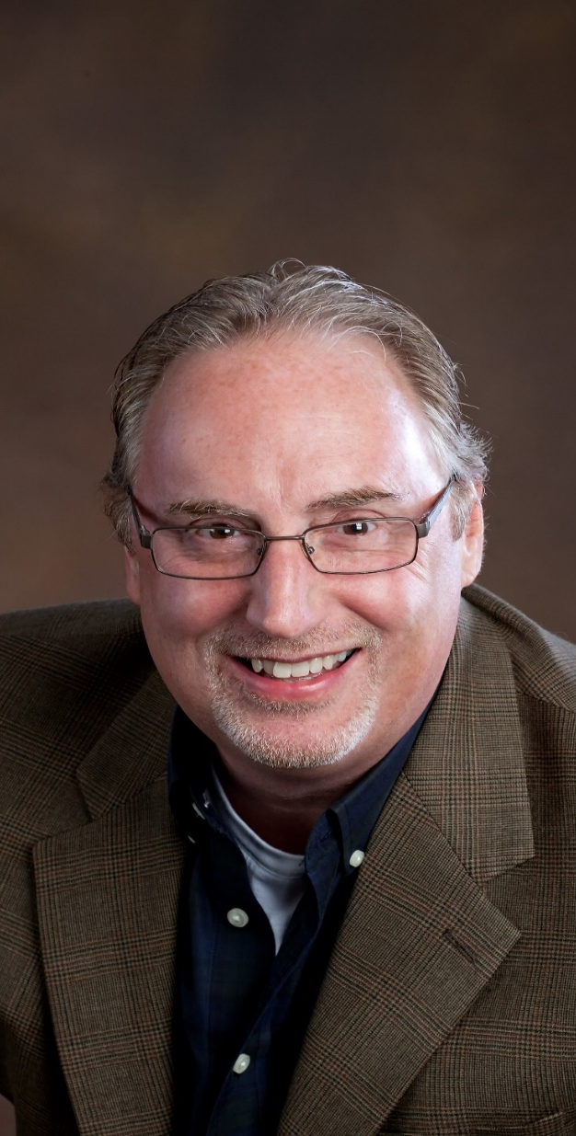
BoB hughes –
Springs Rescue Mission
As Vice President of Programs at Springs Rescue Mission, I see first-hand the destructive power of homelessness on people’s lives. Hopelessness, resulting from substance abuse, mental illness, physical abuse, trauma, neglect and lack of supportive relationships, make homelessness a condition that far too many people in our community experience each day. It is painful to see up close and solutions are not easily found. The Pikes Peak Continuum of Care is committed to finding and/or creating solutions around housing, in all its forms, for as many people as possible. I can get behind that strategy and support it to the fullest extent.

Slide 22
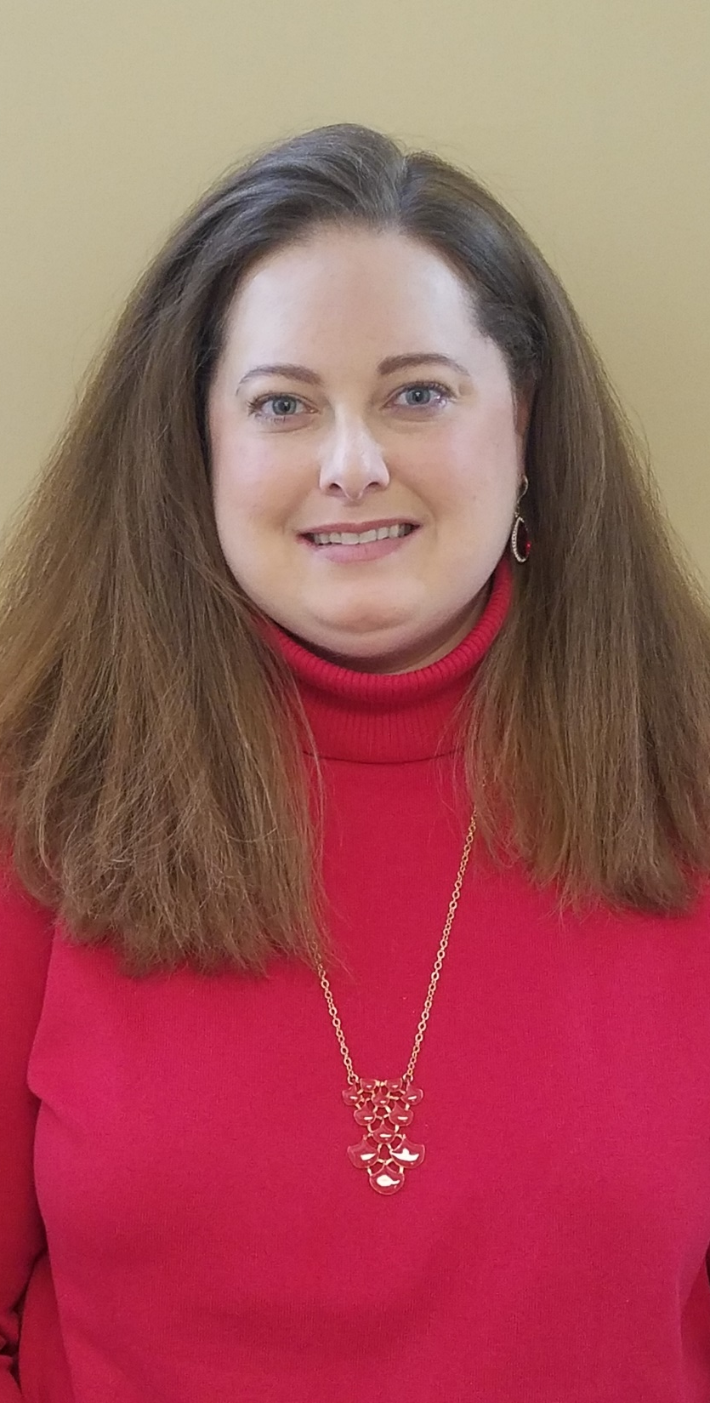
Haley Chapin–
Tri-Lakes cares
I have had the honor of serving Tri-Lakes Cares (TLC) as their Executive Director since March of 2010. TLC focuses on helping the under resourced low-income population of Northern El Paso County by providing products and services such as a food pantry, medical clinic, case management, self-sufficiency programs, financial assistance and more. I know I can be a resource to the CoC by ensuring that when County needs are assessed, outlying and rural areas of our County are not forgotten. Much of my work with TLC has been ‘upstream’ serving the working poor and helping to stabilize them to the point where they don’t lose their housing, employment or transportation resources, and working with them on their path to greater self-sufficiency.

Slide 23
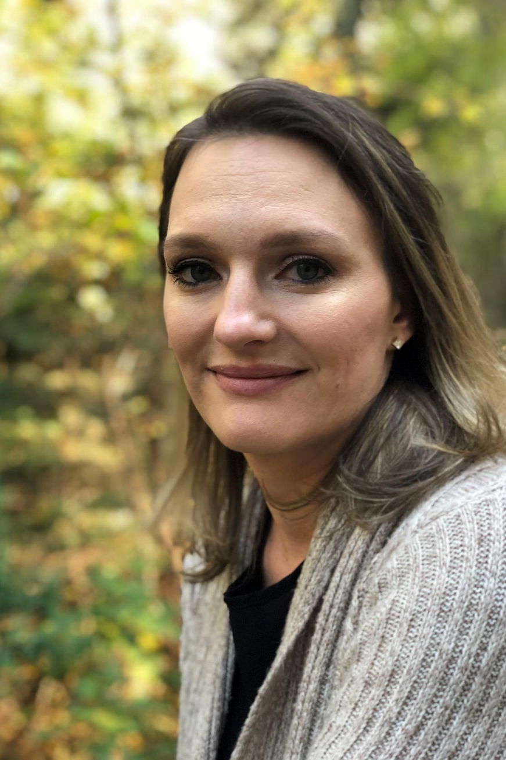
Kat lilley– family promise
I believe our community has made large strides in working to better meet the emergency needs of our community members experiencing homelessness and in providing empowerment to move out of homelessness. I also believe we have more work to do. Knowing first-hand the fear, shame, and hopelessness which stems from homelessness, I am committed to actively working to provide voice to those who often feel invisible and unheard, and working to continue supporting and implementing avenues for recovery and hope with dignity and respect.

Slide 24
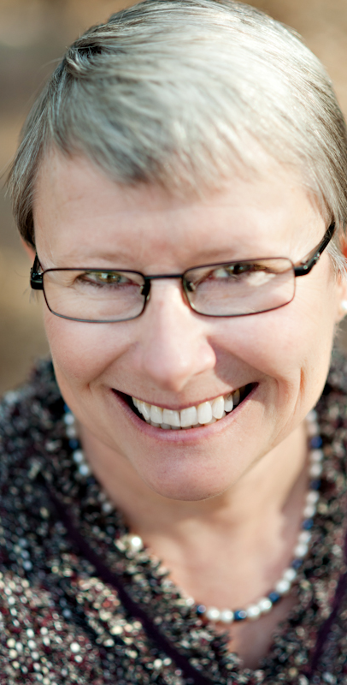
Noreen Landis-tyson –
CPCD
I have committed the last 26 years of my life to working for an organization with a mission to lift families with young children out of poverty, and support children and families in realizing success in school and in life. By serving on the Board of the Continuum of Care, I will share a focus on comprehensive services for those who are homeless, on preventing families from becoming homeless, as well as the importance of partnering with others in the community to make a positive impact, one step at a time, to reduce and end homelessness. This effort is important to our community’s current “health”, as well as the “health” of our community in the future, and deserves our full attention.

Slide 25
PPCoC Charter- Recommended changes
Changes to Section 2, paragraph 4
  Subcommittees, Councils, and Ad-Hoc Committees
  Discussion of proposal:
    Move the description of committees, councils, and other ad-hoc groups sanctioned to carry out the activities of the CoC from the main body of the charter to an addenda section

Slide 26
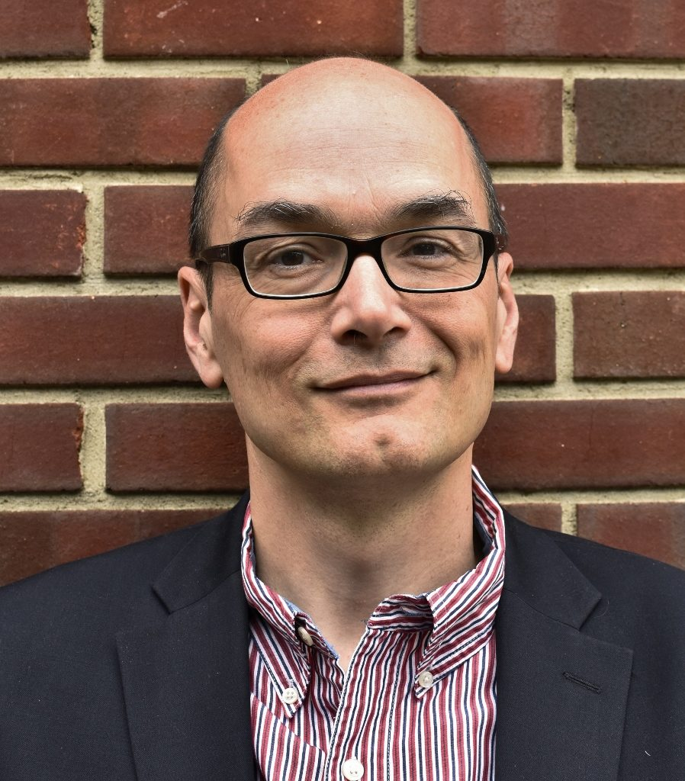

Keynote Speaker
Claas Ehlers, CEO

Slide 27


Questions and Answers

Slide 28
Closing Comments
Call to Action
  Dialogue and Advocate
    Community Plans & Town Halls
    Promote Volunteerism or Donations from Community Groups
    Talk to your Neighbors, Co-Workers, and Faith Groups
  Volunteer
    With a Local Nonprofit – HelpCOS Website “Give Time”
    For PIT Survey Team
    Join a PPCoC Group or Committee

Slide 29
For more information:
Internet Resources:
CHP- https://www.ppchp.org/programs/continuum-of-care/
HelpCOS - https://coloradosprings.gov/helpcos
HUD - https://www.hudexchange.info/programs/coc/
Jennifer Mariano,
PPCoC Program Manager
Community Health Partnership
jennifer.mariano@ppchp.org

